Slide 1
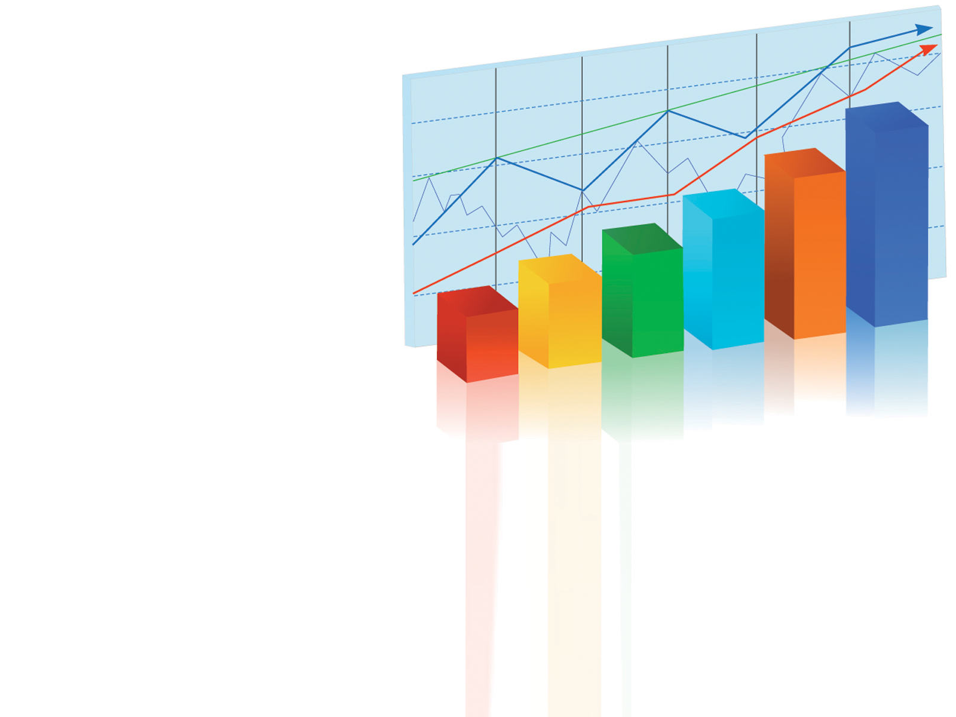
CASE STUDY
EDA ON BRAZIL HOUSING
By Aparna Padmakumar

Slide 2
BRAZIL HOUSING
Rio De Janeiro and Sao Paulo are among the most expensive cities to live in Brazil.
Many people from these cities are considering relocating to a different city to live and work remotely.
Castro Brazila Inc, a top real estate management firm with a nationwide presence in Brazil, wishes to help people choose an alternate city to relocate to.
As a data analyst, help the firm figure out suitable cities for relocation for bachelors, for mid-sized families, and for large families.

Slide 3
UNDERSTANDING DATA
The dataset has 10692 rows and 13 columns
Columns:
Categorical columns
City
Rooms
Bathroom
Parking spaces
Floor
Animal
Furniture
Continuous columns
Area
Hoa (R$)
Rent amount (R$)
Propert tax (R$)
Fire insurance (R$)
Total (R$)
Columns considered for further analysis are city, rooms, bathrooms, Animal, Furniture
Area, Hoa, Rent amount, Property tax and total amount

Slide 4
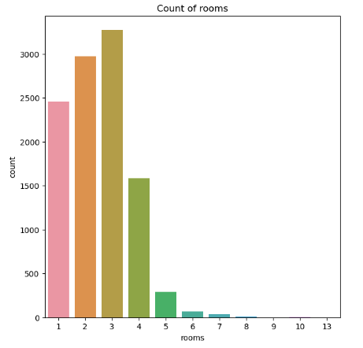
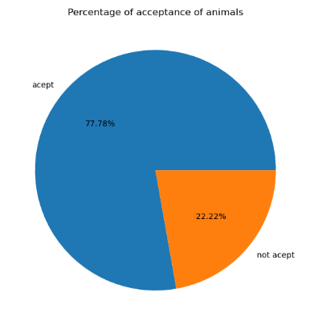
Univariate analysis of categorical columns
Count of rooms
Percentage of acceptance of animal
Interpretation:
Figure 1 shows that most of the houses available for rent have three rooms.
Figure 2 shows that most of the houses available for rent accepts animal.

Slide 5
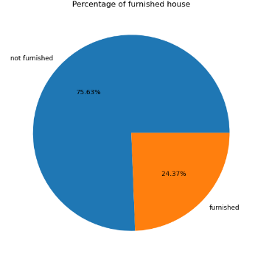
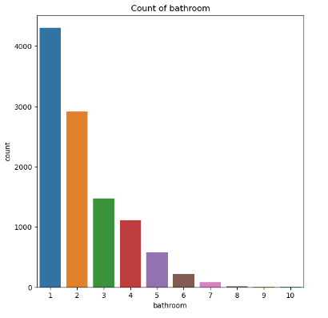
Percentage of furnishes house
Count of bathrooms
Interpretation
Figure 1 suggest that most of the houses available for rent are not furnished.
Figure 2 suggest that most of the houses have 1 bathroom.

Slide 6
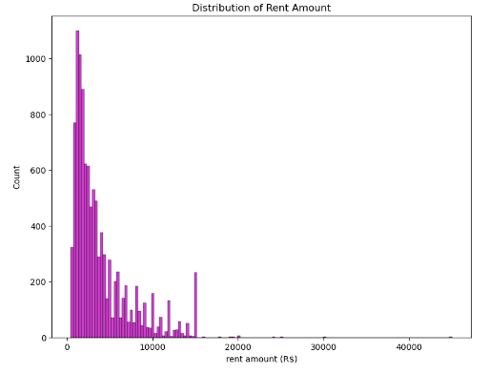
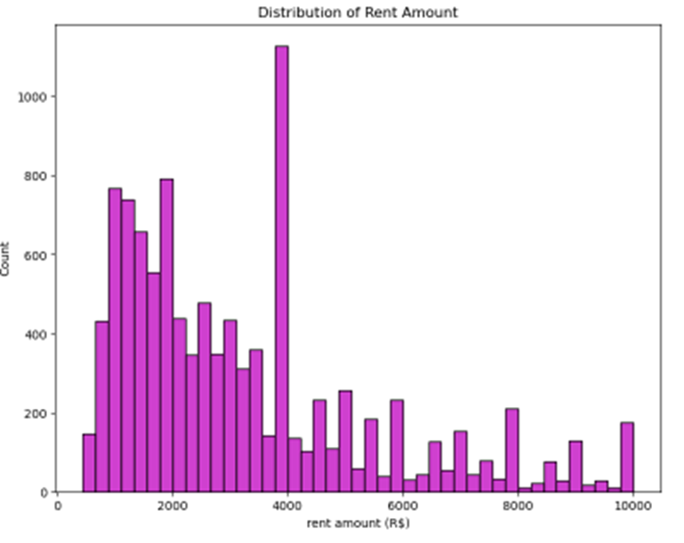
Univariate analysis of continuous columns
Distribution of rent amount
Interpretation:
As we can see in the first graph there are outliers present in the data. So we need to clean the data by removing outliers.

Slide 7

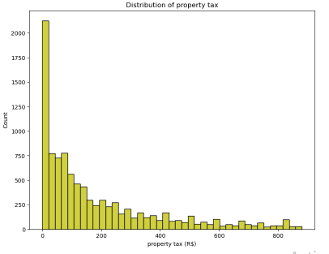
Distribution of rent amount
Distribution of property tax
Interpretation
Fig 1 shows that the maximum rent amount taken is 4000 (R$).
Fig 2 shows that most properties available for rent doesnot takes property tax.

Slide 8
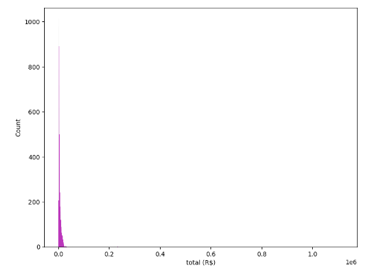
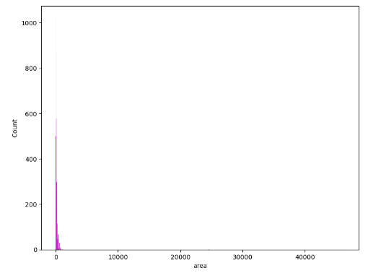
Distribution of Total amount
distribution of area.
Interpretation:
As we can see in the graph both the data has outliers. So we need to clean the data by removal of outliers.

Slide 9
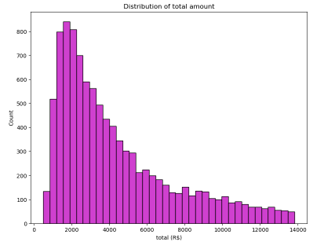
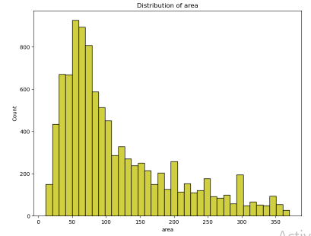
Distribution of Total amount
distribution of area.
Interpretation
By seeing the above graph we can say that majority of total amount of a house for rent is 2000 (R$).
In Fig 2 most of the houses have area ranging from 50 to 100 square meters.

Slide 10
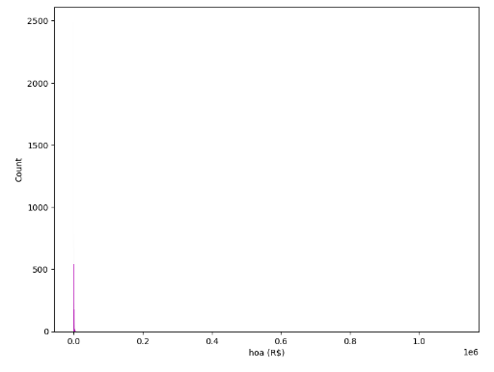
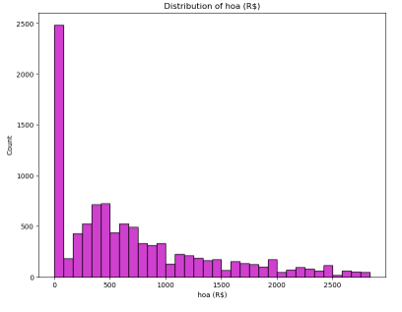
Distribution of home owner association tax
Interpretation
As we can see in Fig 1 there are outliers present in data so we have to clean the data first by removing outliers.
After removal of outliers we can see that most of the properties available for rent does not take Homeowner association tax.

Slide 11
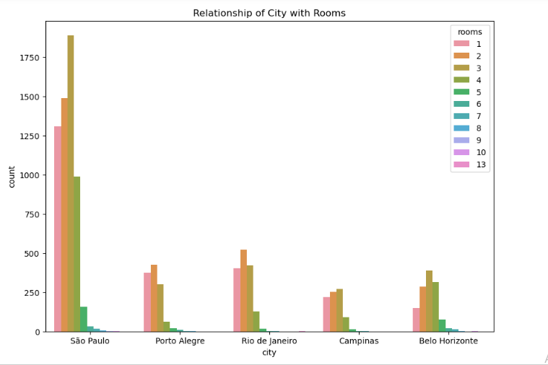
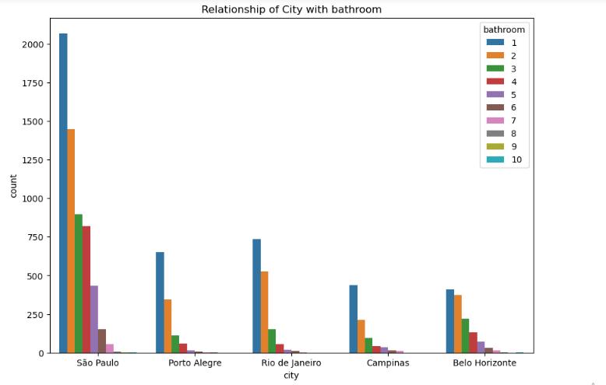
Level 2 : Bi-Variate Analysis
Relationship of city with rooms
Relationship of city with rooms
Interpretation: By observing above graph we can see the number of rooms that properties available for rent have.
Interpretation: Above graph shows the number of bathrooms that properties available for rent have.

Slide 12
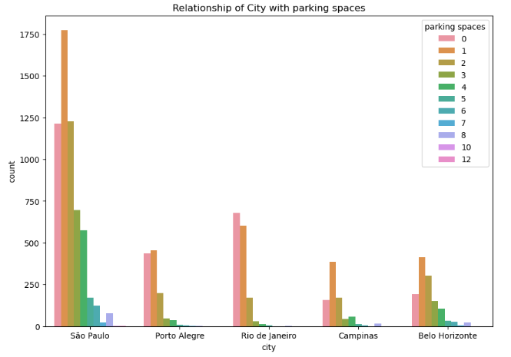
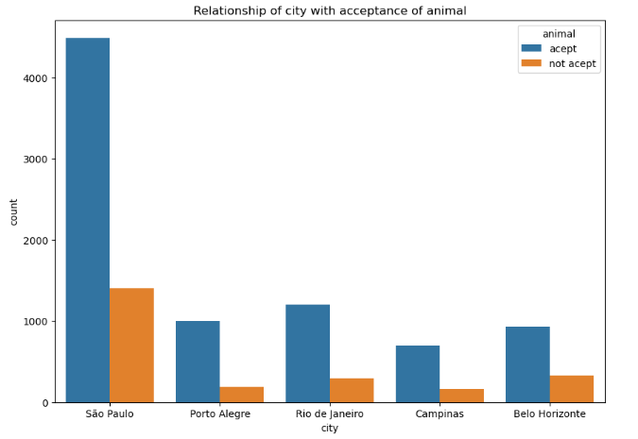
Distribution of number of parking spaces per city
Distribution of acceptance of animal per city
Interpretation: Campinas have least acceptance of animal
Interpretation: Porto Alegre has most number of 0 to 1 parking spaces.

Slide 13
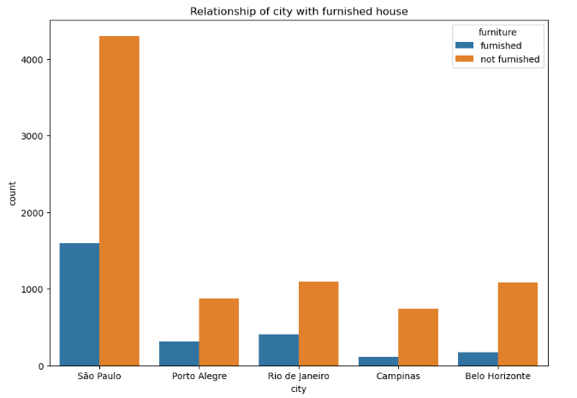
Relationship of city with furnished house
Interpretation: In this graph we can see that Porto Alegre has most number of furnished property and Campinas and Belo Horizonte has least.

Slide 14
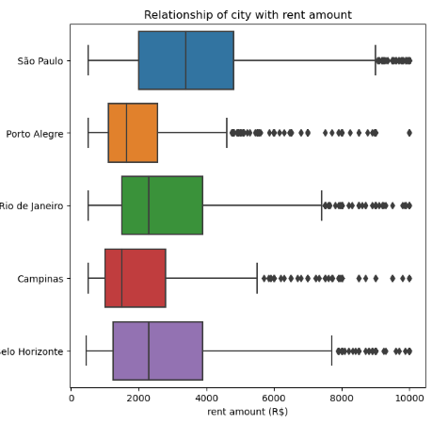
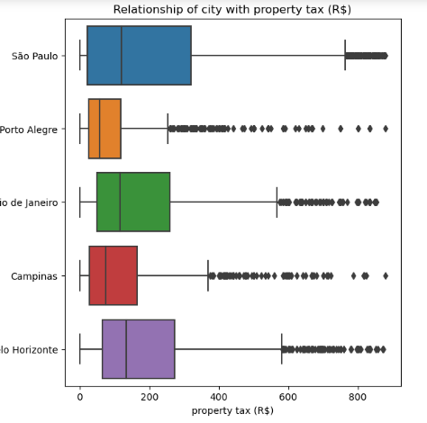
CAT NUM ANALYSIS: Categorical to continuous
Interpretation: Porto Alegre has the least amount of rent amount and Campinas has a moderate rent amount for properties that are in rent
Interpretation: Porto Alegre has the least amount of property tax and Campinas have a moderate amount of property tax.

Slide 15
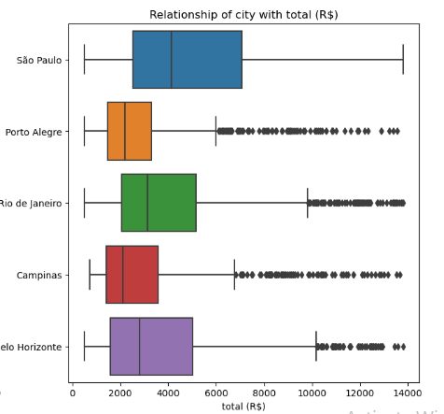
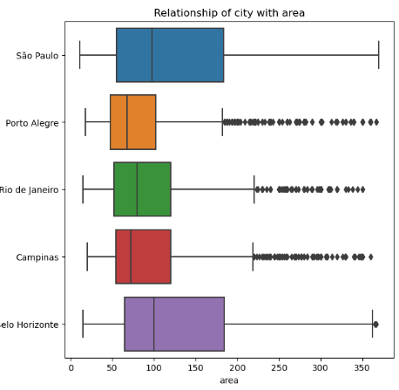
Interpretation:
Porto Alegre has less total cost than others.
Interpretation:
Porto Alegre is the city with least area of properties in rent whereas Campinas and Belo Horizonte has more.

Slide 16
CONCLUSION
By overall analysis Porto Alegre appears to be a suitable city for bachelors. This city likely offers a higher proportion of smaller accommodation, which aligns with the needs of bachelors. Additionally the city has higher acceptance of animals with lower rent amount that other cities which could be attractive to bachelors
Campinas emerges as a favorable city for mid sized families. It offers a variety of housing options with sufficient number of rooms, parking spaces, bathrooms that are suitable for the mid sized family needs.
Belo Horizonte is identified as a suitable city for large family based on the analysis. The city likely provides a higher number of housing option with large number of rooms, parking spaces, bathrooms etc, accommodating the space requirement for large families

Slide 17
THANKYOU

